Slide 1
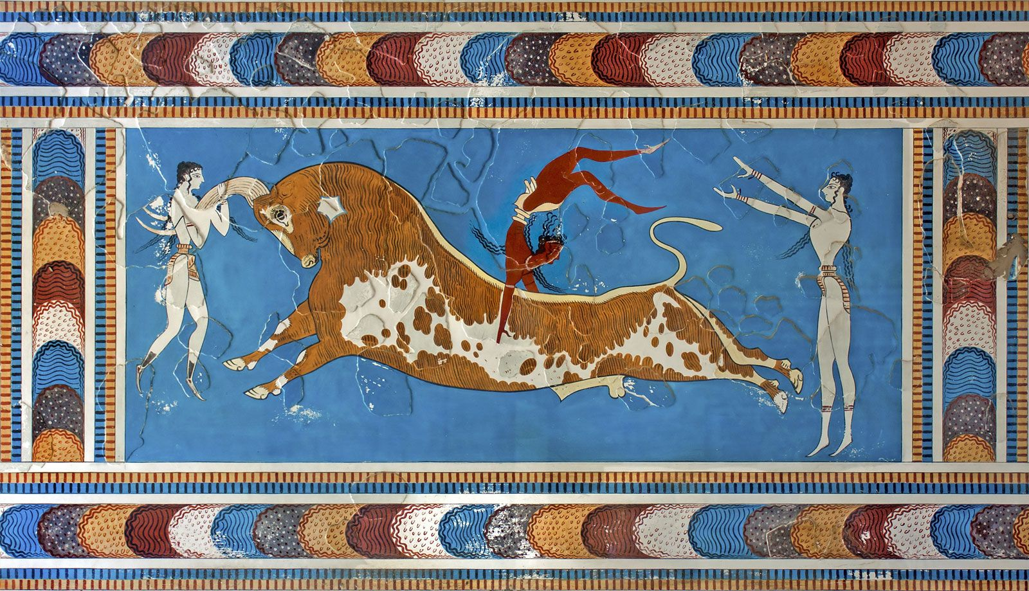
Revision – Source Analysis
Goal/s:
Revise key minoan content
Identify the steps for source analysis
Week 4 Lesson 1
Ms Barrie

Slide 2
This week:
Tuesday
Revise the Minoan civilization content and learn the steps to successfully complete a Source Analysis test
Wednesday
Revise the skills questions in your Source Analysis test, and how to successfully answer them
Thursday
Private/Independent study
Friday
Learning Task 1: Source Analysis

Slide 3

ACTIVITY 1 – Mind Map
As a class, will create a mind map on the features of the Minoan Civilization
This is to revise the CONTENT we have covered so far.
DISCUSSION QUESTIONS:
What is the difference between CONTENT and SKILLS?
What features does a GOOD mind map have?

Slide 4
The Minoans

Slide 5
ACTIVITY 2 – Steps to analyse sources
So you get your test in front of you on Friday.
What do you do?
🧐
Notes:
Initiate class discussion

Slide 6
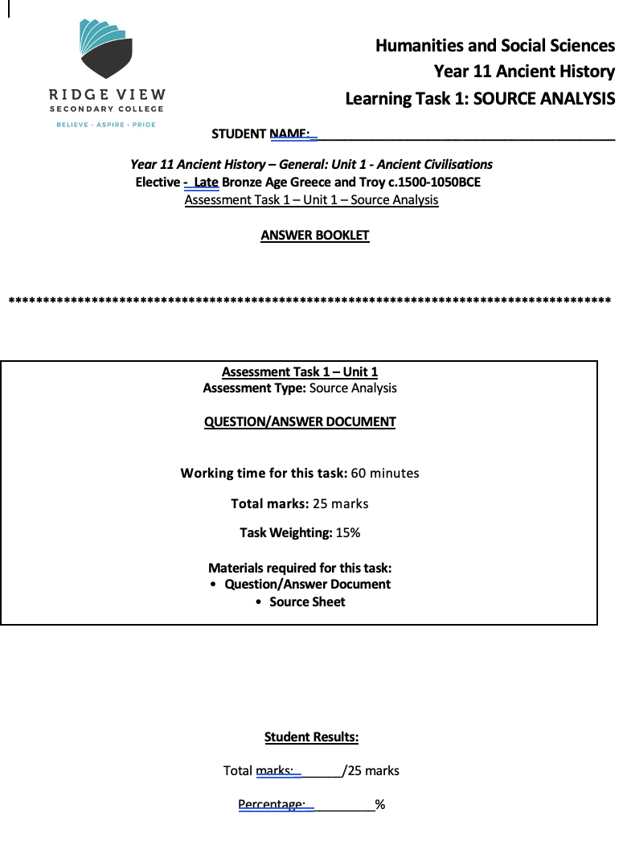
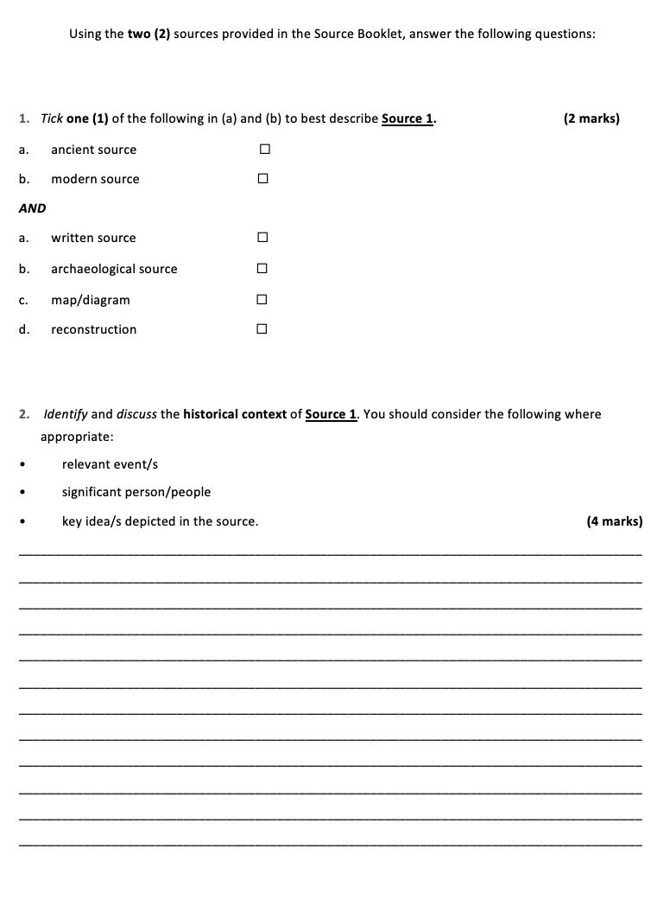
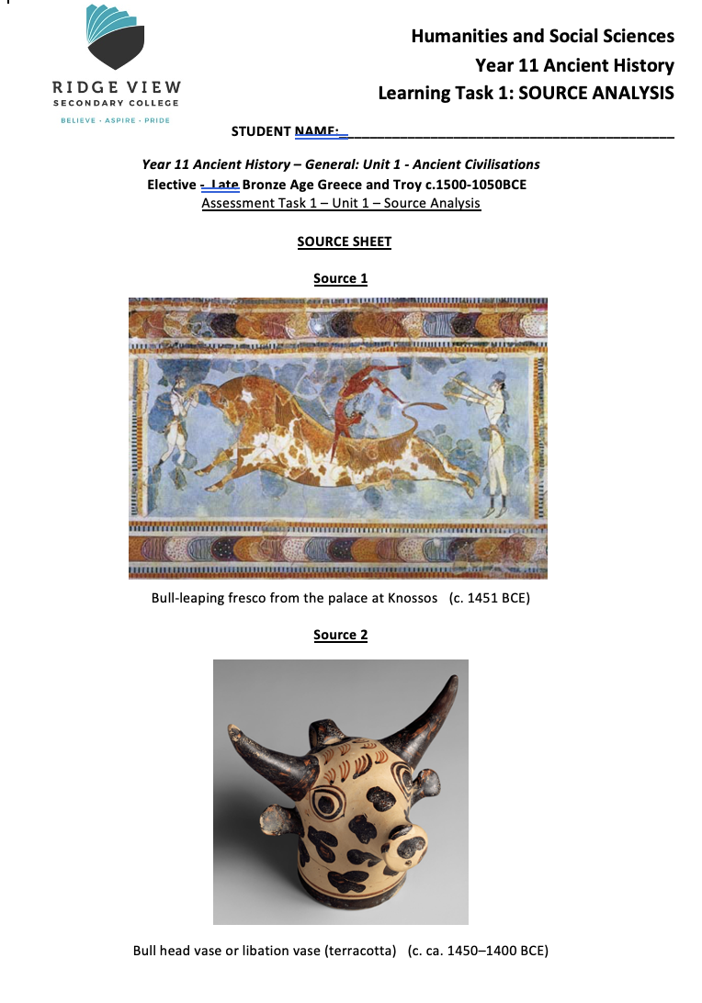
STEPS TO ANALYSING SOURCES
STEP 1 – Have a look through the Source Analysis in its entirety (1 - 2 min)

Slide 7
STEPS TO ANALYSING SOURCES
STEP 2 – Annotate the sources (1 – 2 minutes)

Slide 8
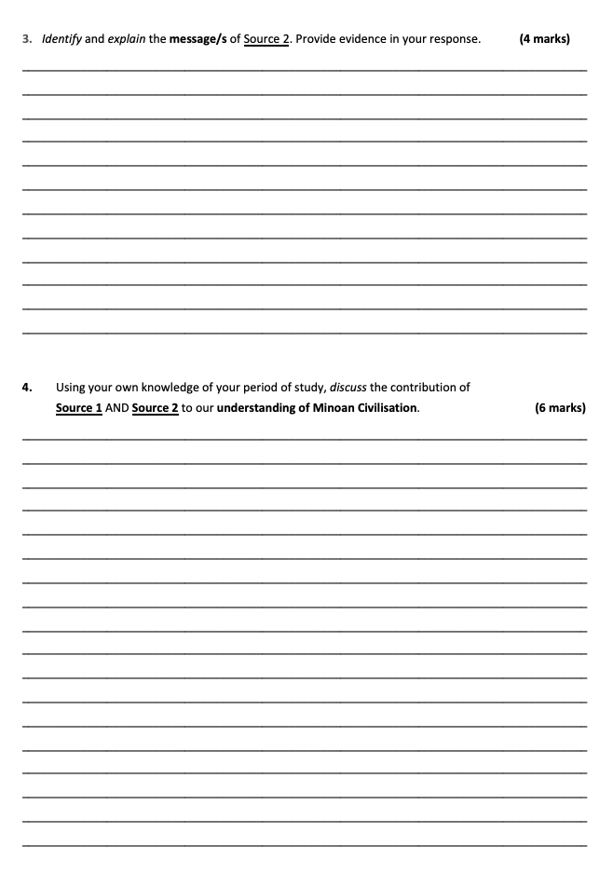
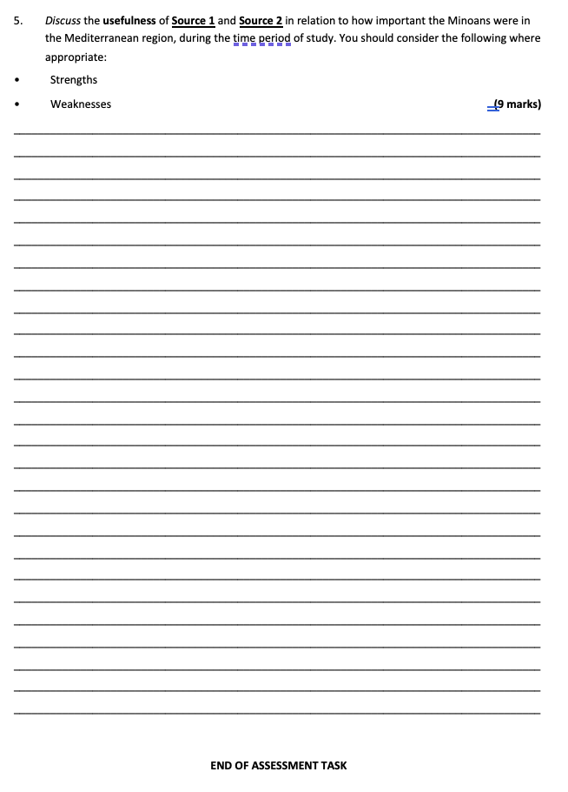
STEPS TO ANALYSING SOURCES
STEP 3 – Plan your questions (1 min)

Slide 9
STEPS TO ANALYSING SOURCES
STEP 4 – Answer your questions

Slide 10
STEPS TO ANALYSING SOURCES
STEP 5 – CHECK AND EDIT YOUR ANSWERS

Slide 11
The best Source Analysis answers will…
Use the question in their answer (e.g. “The historical context of Source 1 is…”)
Use formal language (NO I, we, you, our, things, stuff)
Be edited for spelling, grammar, and understanding (does it actually make sense?)
Have enough for the amount of marks – 4 marks = 4 good points!

Slide 12
The worst Source Analysis answers will…
Not be attempted (you lose marks!)
Use informal language (I think that…)
Not be edited
Not answer the question – don’t just write everything you know!

Slide 13
Revision – Source Analysis
Goal/s:
Revise key questions
practice source analysis skills
Week 4 Lesson 2
Ms Barrie

Slide 14
This week:
Tuesday
Revise the Minoan civilization content and learn the steps to successfully complete a Source Analysis test
Wednesday
Revise the skills questions in your Source Analysis test, and how to successfully answer them
Thursday
Private/Independent study
Friday
Learning Task 1: Source Analysis

Slide 15

ACTIVITY - Worksheet
We will analyse each question in your upcoming Source Analysis test.
I will teach you HOW to answer each question, how many MARKS there are for each, and give you a GOOD sample answer (for a practice source).

Slide 16
Question 1
Tick one (1) of the following in (a) and (b) to best describe Source 1. (2 marks)
ancient source ☐
modern source ☐
AND
written source ☐
archaeological source ☐
map/diagram ☐
reconstruction ☐
Description | Marks
Correctly identifies the descriptions of Source 1 (Ancient & Archaeological Source) | 1 - 2
No/incorrect attempt at Question 1 | 0
Total: | 2

Slide 17
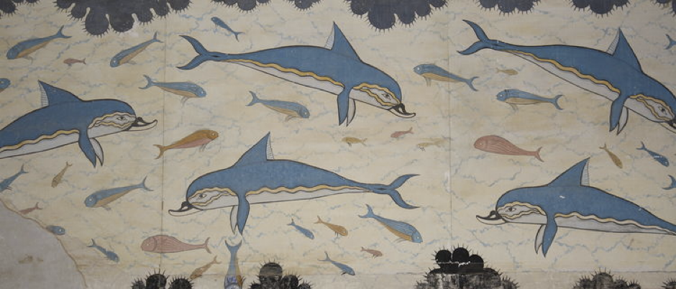
Question 1 – Sample Answer
Tick one (1) of the following in (a) and (b) to best describe Source 1. (2 marks)
ancient source ☐
modern source ☐
AND
written source ☐
archaeological source ☐
map/diagram ☐
reconstruction ☐
A detail of the dolphin fresco Minoan palace of Knossos, Crete, (c. 1700-1450 BCE)
Description | Marks
Correctly identifies the descriptions of Source 1 (Ancient & Archaeological Source) | 1 - 2
No/incorrect attempt at Question 1 | 0
Total: | 2

Slide 18
Question 2
Identify and discuss the historical context of Source 1. You should consider the following where appropriate: relevant event/s, significant person/people, key idea/s depicted in the source.
(4 marks)
Description | Marks
Accurately identifies and discusses the historical context of Source 1, demonstrating a sound historical knowledge of the period. The answer includes discussion of: relevant event/s and/or significant person/people and/or key idea/s | 4
Identifies and briefly discusses the historical context of Source 1, demonstrating some historical knowledge of the period, but with omissions. The answer includes discussion of: relevant event/s and/or, significant person/people and/or, key idea/s | 3
Identifies and provides a simple description the historical context of Source 1, demonstrating a limited historical knowledge of the period. The answer includes discussion of: relevant event/s and/or significant person/people and/or key idea/s | 2
The answer demonstrates little historical knowledge of the period, with very simple description of: One (or two) of the criteria mentioned above, or The answer is factually inaccurate, or The answer simply describes the source | 1
No/incorrect attempt at Question 2 | 0
Total: | 4

Slide 19
Question 2 – Sample Answer
Identify and discuss the historical context of Source 1. You should consider the following where appropriate: relevant event/s, significant person/people, key idea/s depicted in the source.
(4 marks)
A detail of the dolphin fresco Minoan palace of Knossos, Crete, (c. 1700-1450 BCE)
Description | Marks
Accurately identifies and discusses the historical context of Source 1, demonstrating a sound historical knowledge of the period. The answer includes discussion of: relevant event/s and/or significant person/people and/or key idea/s | 4
Identifies and briefly discusses the historical context of Source 1, demonstrating some historical knowledge of the period, but with omissions. The answer includes discussion of: relevant event/s and/or, significant person/people and/or, key idea/s | 3
Identifies and provides a simple description the historical context of Source 1, demonstrating a limited historical knowledge of the period. The answer includes discussion of: relevant event/s and/or significant person/people and/or key idea/s | 2
The answer demonstrates little historical knowledge of the period, with very simple description of: One (or two) of the criteria mentioned above, or The answer is factually inaccurate, or The answer simply describes the source | 1
No/incorrect attempt at Question 2 | 0
Total: | 4

Slide 20
Question 3
Identify and explain the message/s of Source 2. Provide evidence in your response. (4 marks)
Description | Marks
Accurately identifies and clearly explains the message/s of Source 2. Provides clear evidence to support the answer. | 4
Identifies and briefly explains the message/s of Source 2. Provides limited evidence to support the answer. | 3
Identifies and describes a message of Source 2, with little explanation and/or evidence provided. | 2
Answer reflects little understanding of Source 2, with a simple recount of the contents of the source. | 1
No/incorrect attempt at Question 3 | 0
Total: | 4

Slide 21
Question 3 – Sample Answer
Identify and explain the message/s of Source 2. Provide evidence in your response. (4 marks)
A detail of the dolphin fresco Minoan palace of Knossos, Crete, (c. 1700-1450 BCE)
Description | Marks
Accurately identifies and clearly explains the message/s of Source 2. Provides clear evidence to support the answer. | 4
Identifies and briefly explains the message/s of Source 2. Provides limited evidence to support the answer. | 3
Identifies and describes a message of Source 2, with little explanation and/or evidence provided. | 2
Answer reflects little understanding of Source 2, with a simple recount of the contents of the source. | 1
No/incorrect attempt at Question 3 | 0
Total: | 4

Slide 22
Question 4
Using your own knowledge of your period of study, discuss the contribution of Source 1 AND Source 2 to our understanding of Minoan Civilisation. (6 marks)
Description | Marks
SOURCE 1
Discusses the contribution of Source 1 to an understanding of Minoan society Draws on own knowledge of the period of study and other sources to discuss the contribution of Source 1 to an understanding of Minoan society | 3
States the contribution of Source 1 to an understanding of Minoan society Makes limited use of own knowledge or other sources to support the answer | 1 - 2
Student does not discuss/incorrectly discusses the contribution of Source 1 to our understanding of Minoan Civilisation. | 0
SOURCE 2
Discusses the contribution of Source 2 to an understanding of Minoan society Draws on own knowledge of the period of study and other sources to discuss the contribution of Source 2 to an understanding of Minoan society | 3
States the contribution of Source 2 to an understanding of Minoan society Makes limited use of own knowledge or other sources to support the answer | 1 - 2
Student does not discuss/incorrectly discusses the contribution of Source 2 to our understanding of Minoan Civilisation. | 0
Total: | 6

Slide 23
Question 4 – Sample Answer
Using your own knowledge of your period of study, discuss the contribution of Source 1 AND Source 2 to our understanding of Minoan Civilisation. (6 marks)
Description | Marks
SOURCE 1
Discusses the contribution of Source 1 to an understanding of Minoan society Draws on own knowledge of the period of study and other sources to discuss the contribution of Source 1 to an understanding of Minoan society | 3
States the contribution of Source 1 to an understanding of Minoan society Makes limited use of own knowledge or other sources to support the answer | 1 - 2
Student does not discuss/incorrectly discusses the contribution of Source 1 to our understanding of Minoan Civilisation. | 0
SOURCE 2
Discusses the contribution of Source 2 to an understanding of Minoan society Draws on own knowledge of the period of study and other sources to discuss the contribution of Source 2 to an understanding of Minoan society | 3
States the contribution of Source 2 to an understanding of Minoan society Makes limited use of own knowledge or other sources to support the answer | 1 - 2
Student does not discuss/incorrectly discusses the contribution of Source 2 to our understanding of Minoan Civilisation. | 0
Total: | 6

Slide 24
Question 5
Discuss the usefulness of Source 1 and Source 2 in relation to how important the Minoans were in the Mediterranean region, during the time period of study. You should consider the following where appropriate: Strengths, Weaknesses (9 marks)
Description | Marks
Accurately identifies at least one strength and one weakness of Source 1 using examples from their knowledge and from the source | 1 - 3
Accurately identifies at least one strength and one weakness of Source 2 using examples from their knowledge and from the source | 1 - 3
Links both Source 1 and Source 2 back to their importance to Minoan society 1-3 | 1 - 3
No/incorrect Attempt at Question 5. | 0
Total: | 9

Slide 25
Revision – Source Analysis
Goal/s:
Revise key questions
practice source analysis skills
Week 4 Lesson 2
Ms Barrie

Slide 26
This week:
Tuesday
Revise the Minoan civilization content and learn the steps to successfully complete a Source Analysis test
Wednesday
Revise the skills questions in your Source Analysis test, and how to successfully answer them
Thursday
Private/Independent study
Friday
Learning Task 1: Source Analysis

Slide 27
TO DO:
Create flash cards of Key ideas (SPERMC)
Memorise how to answer questions
Test each other on knowledge
Create a Study Sheet from memory
Practice Sources

